Slide 1
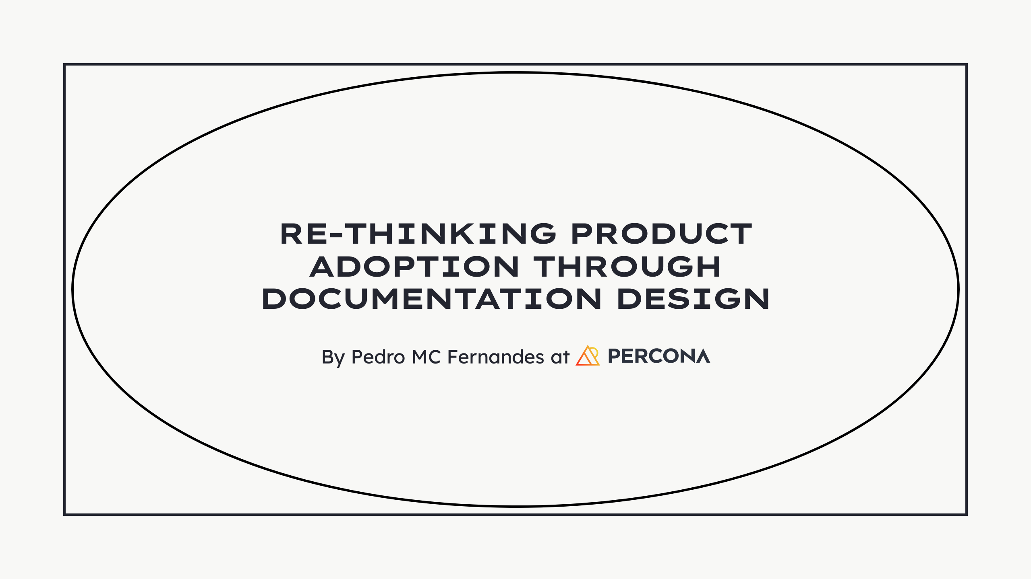

Slide 2
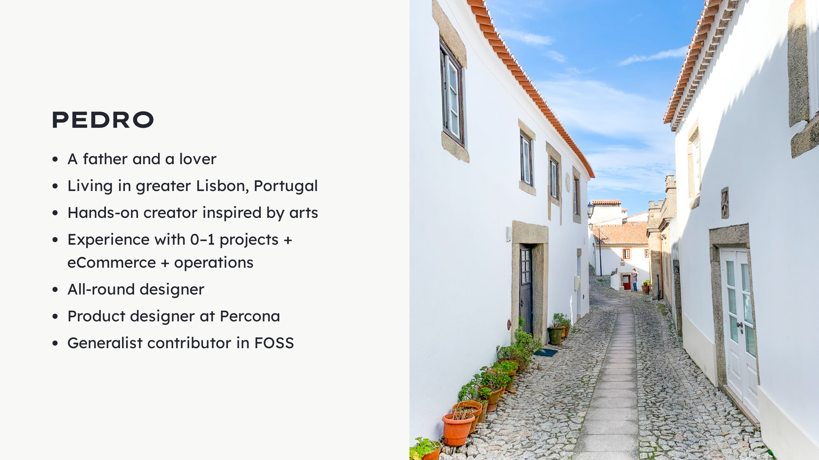
Notes:
Who's Pedro?

Slide 3
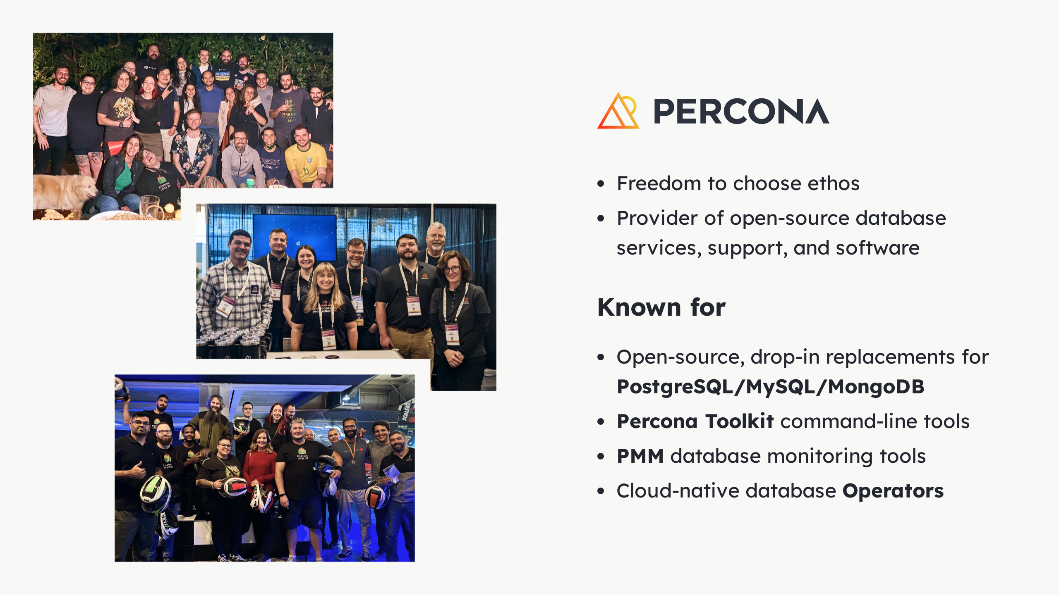
Notes:
Where is this happening? - Born out DB solutions - That wouldn't break the bank - For small, growing and large companies - Later, open-source software - Freedom to choose - To support services, namely...

Slide 4
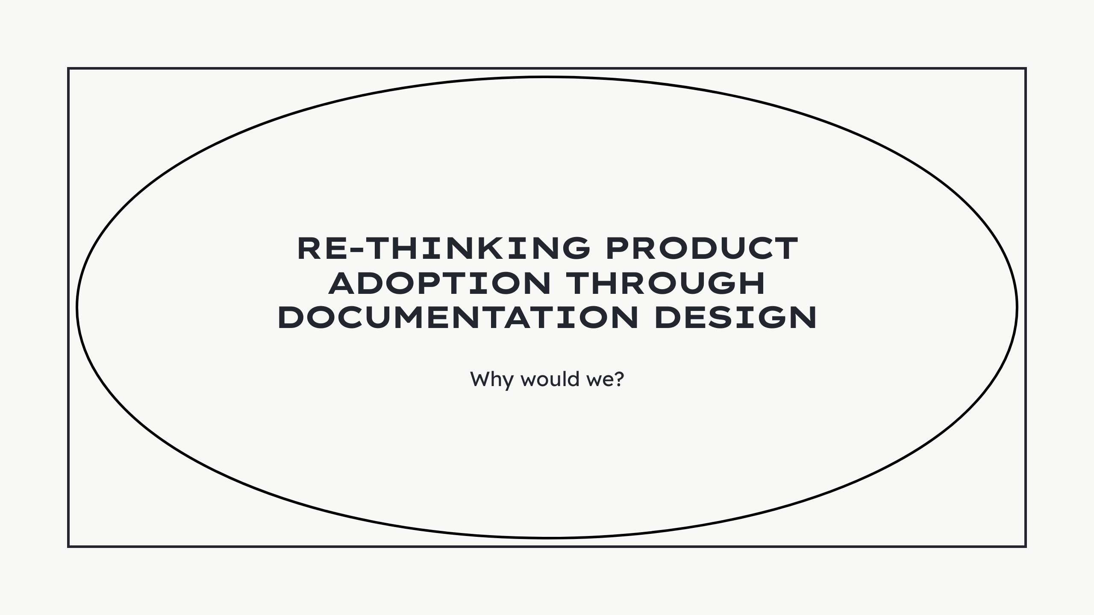
Notes:
- Why would we want to shape docs? - Why improve them? - Why would we care about docs 1st and software growth later?

Slide 5
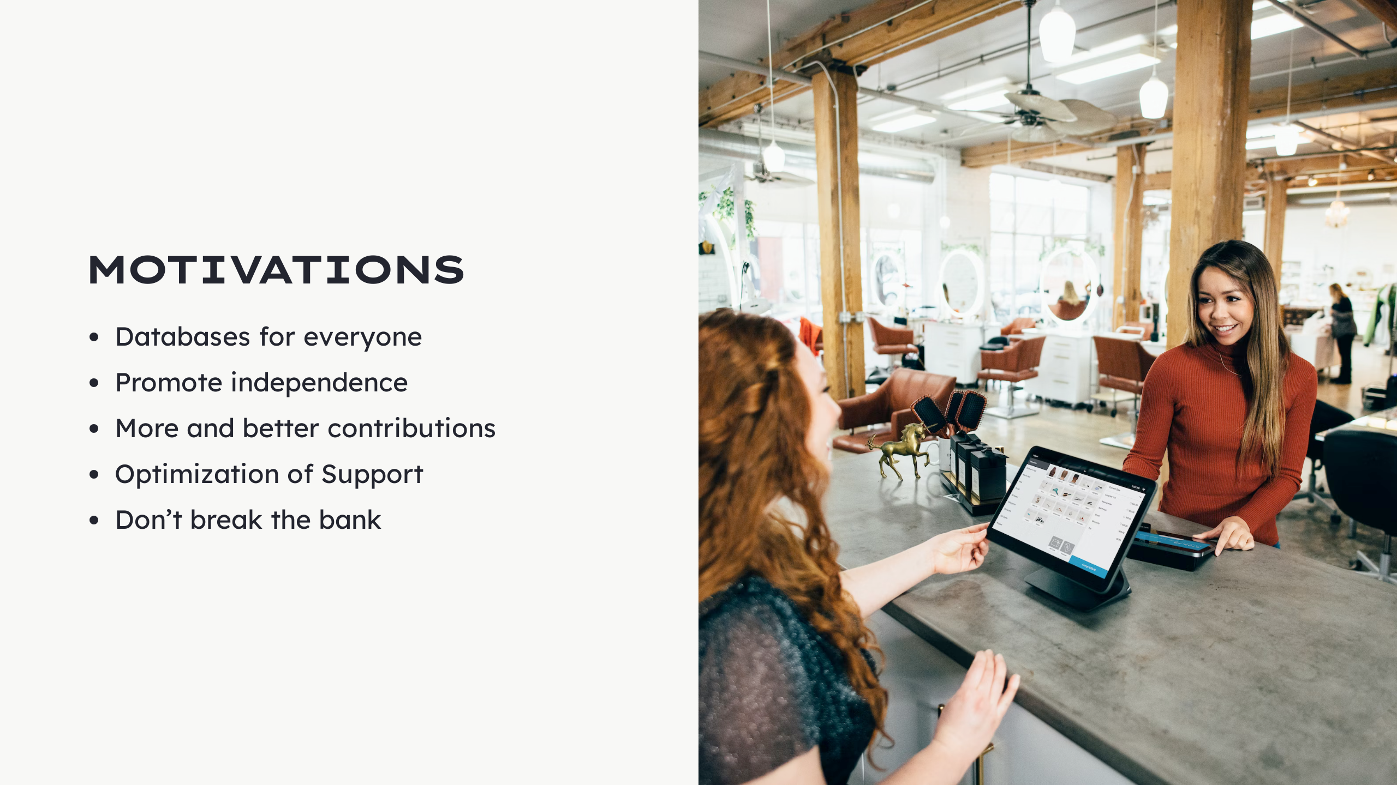
Notes:
Here are some of our motivations: - Databases for everyone - Any technical background - Spark creativity - Help learn databases - Promote independence - Lower the entry barrier - Reduce effort and time - More and better contributions - Increase discussion - Multiply solutions - For anyone - Optimization of Support - Focus on bigger problem - Societal blockers - Don’t break the bank - Anyone can get in - Regardless of price - Grow at their pace - Scale when ready Documentation can help.

Slide 6
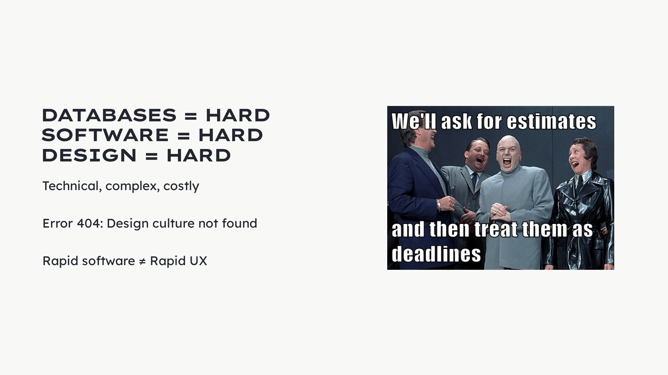
Notes:
- Technical, complex, costly - Intimidating - Specific terminology - Abstract structures - Lack user centricity - Increase user base = more research costs - Error 404, Design culture not found - Percona - Wasn't born user-centric - Focused on technical solutions - Working/not working things - Rapid software ≠ Rapid UX - If they're not synchronized - Needs deep integration - Team - Processes - More time spent - Documentation - Demystify - Reach more people

Slide 7
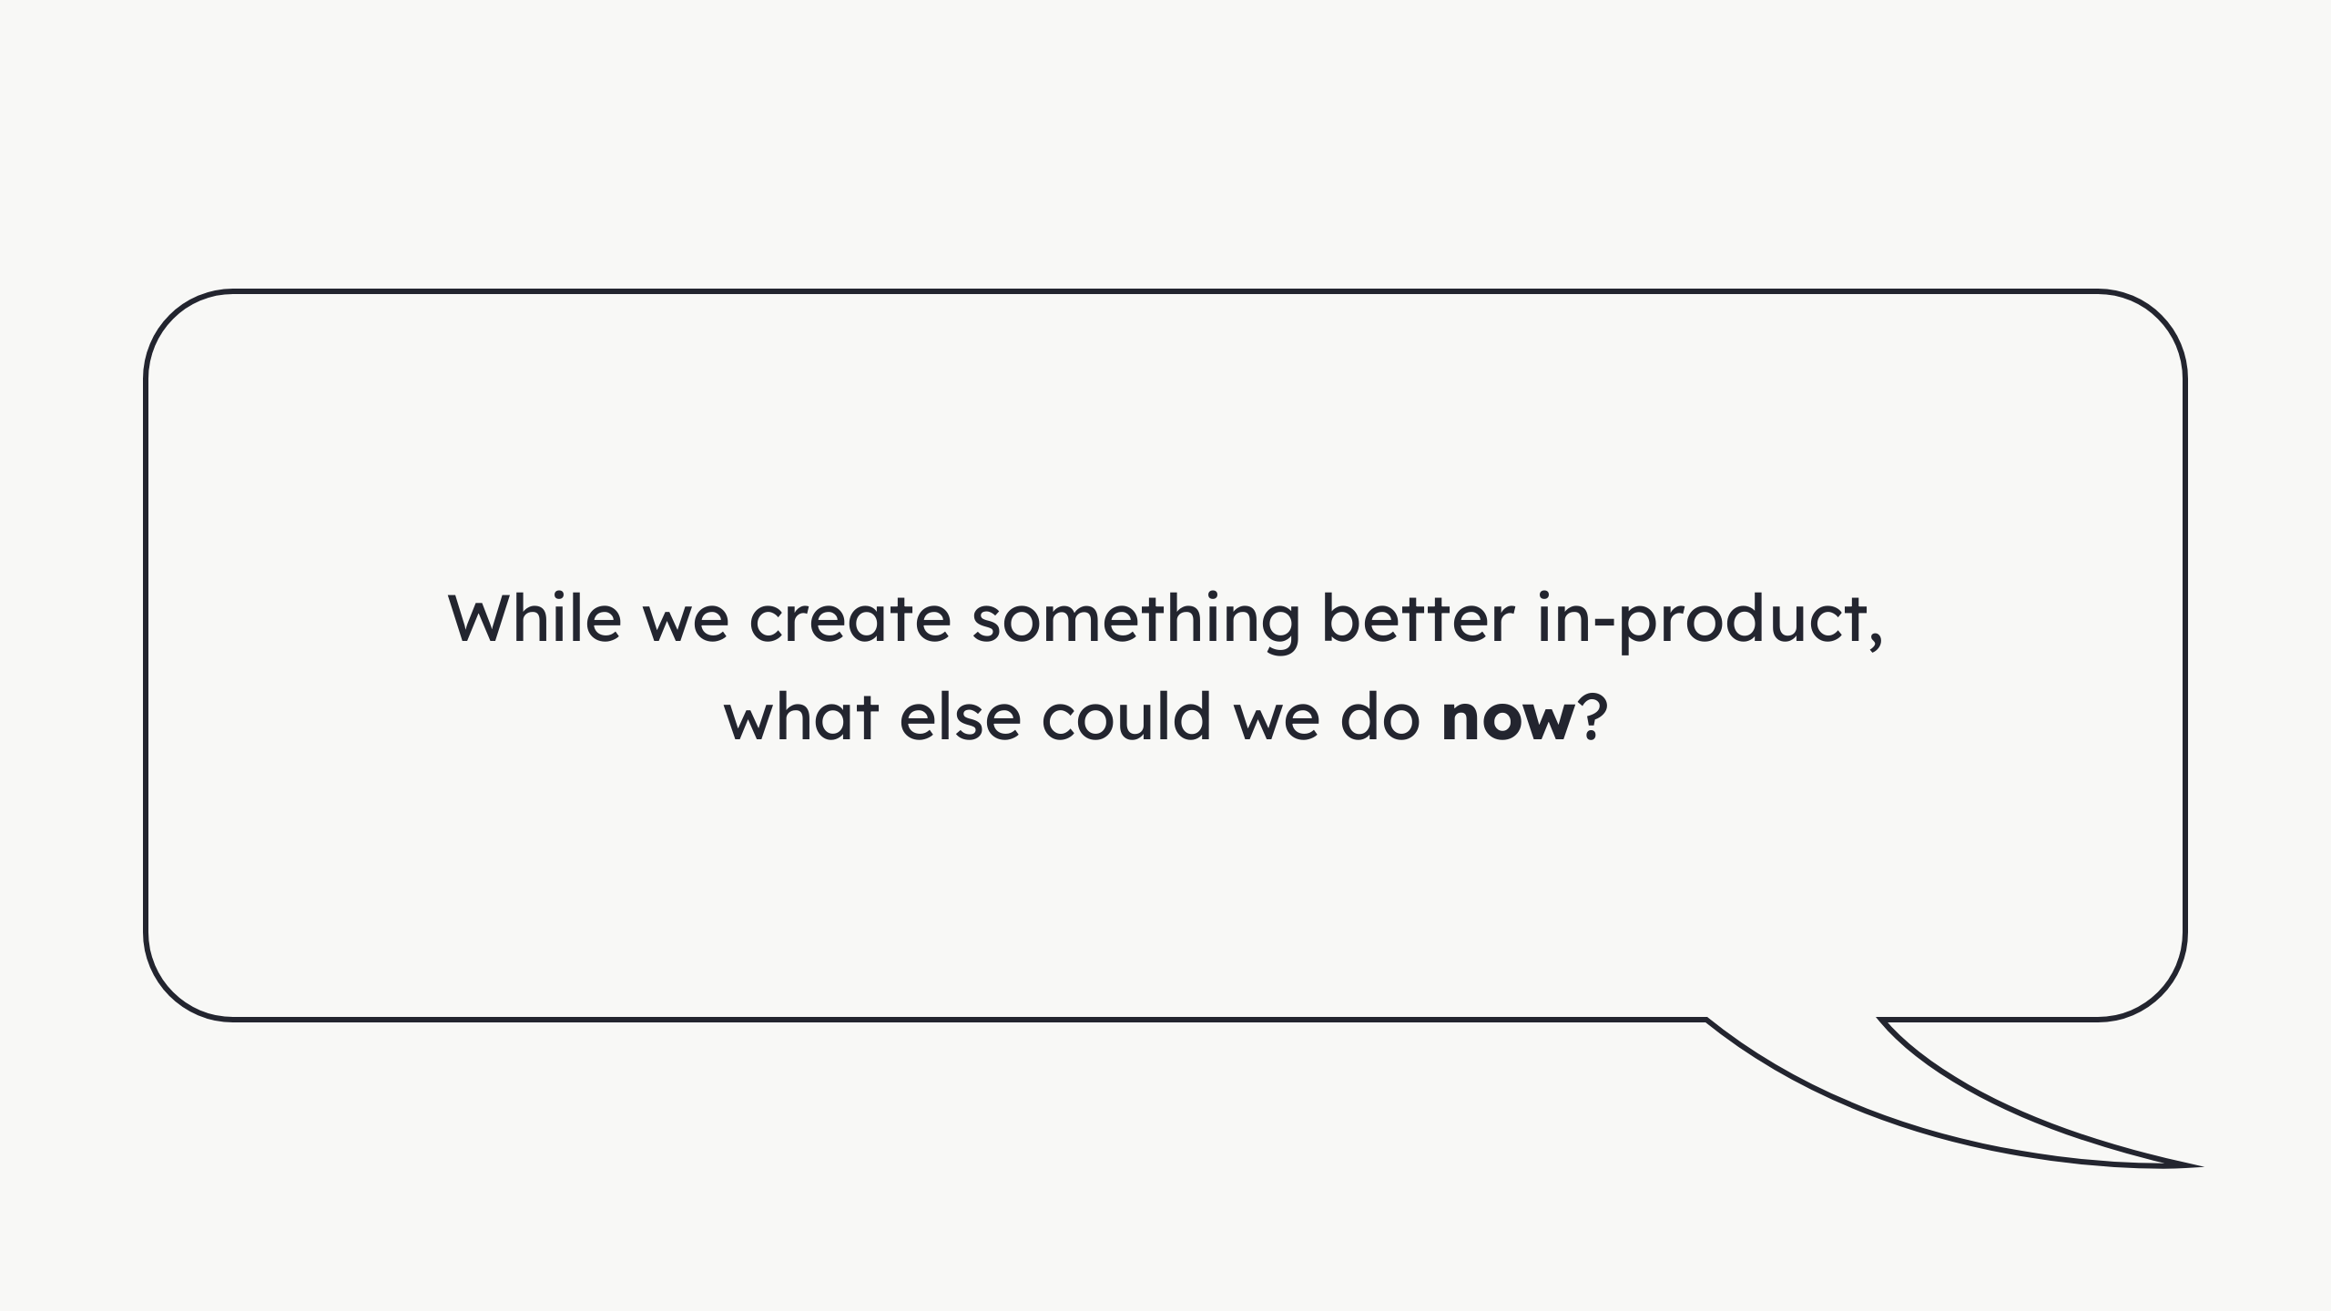

Slide 8
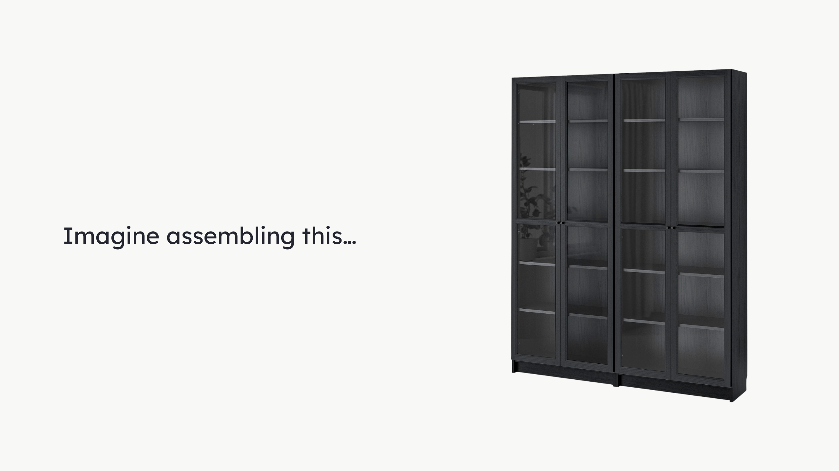
Notes:
Ikea Billy bookshelf with Oxberg doors. Anyone had a chance of assembling one of these? I nailed the back, faced the wrong direction. Wood grain, unpainted from the inside. Had to get some more of those micro nails...

Slide 9

Notes:
...Where each part goes. - Doors one sided - All either left or right - Had to unscrew everything - Door ugly - Chipped inside

Slide 10
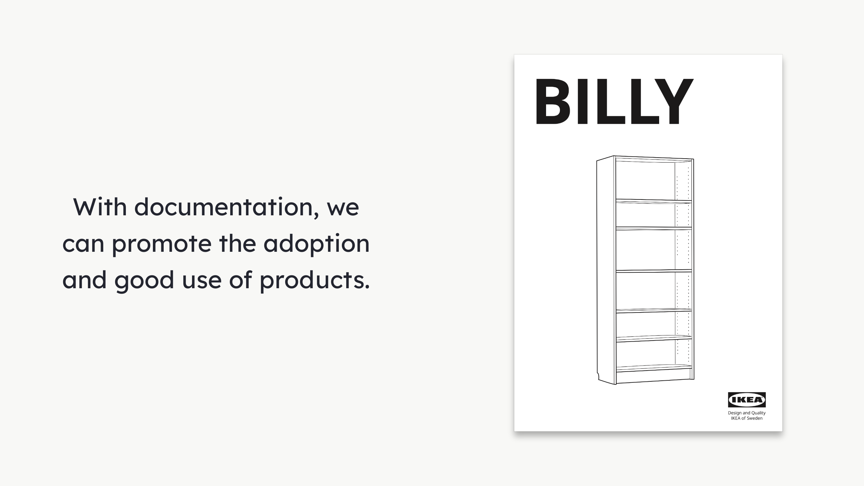
Notes:
- Well designed documentation - Like IKEA's instructions booklet - Errors can still happen - Improves the output

Slide 11
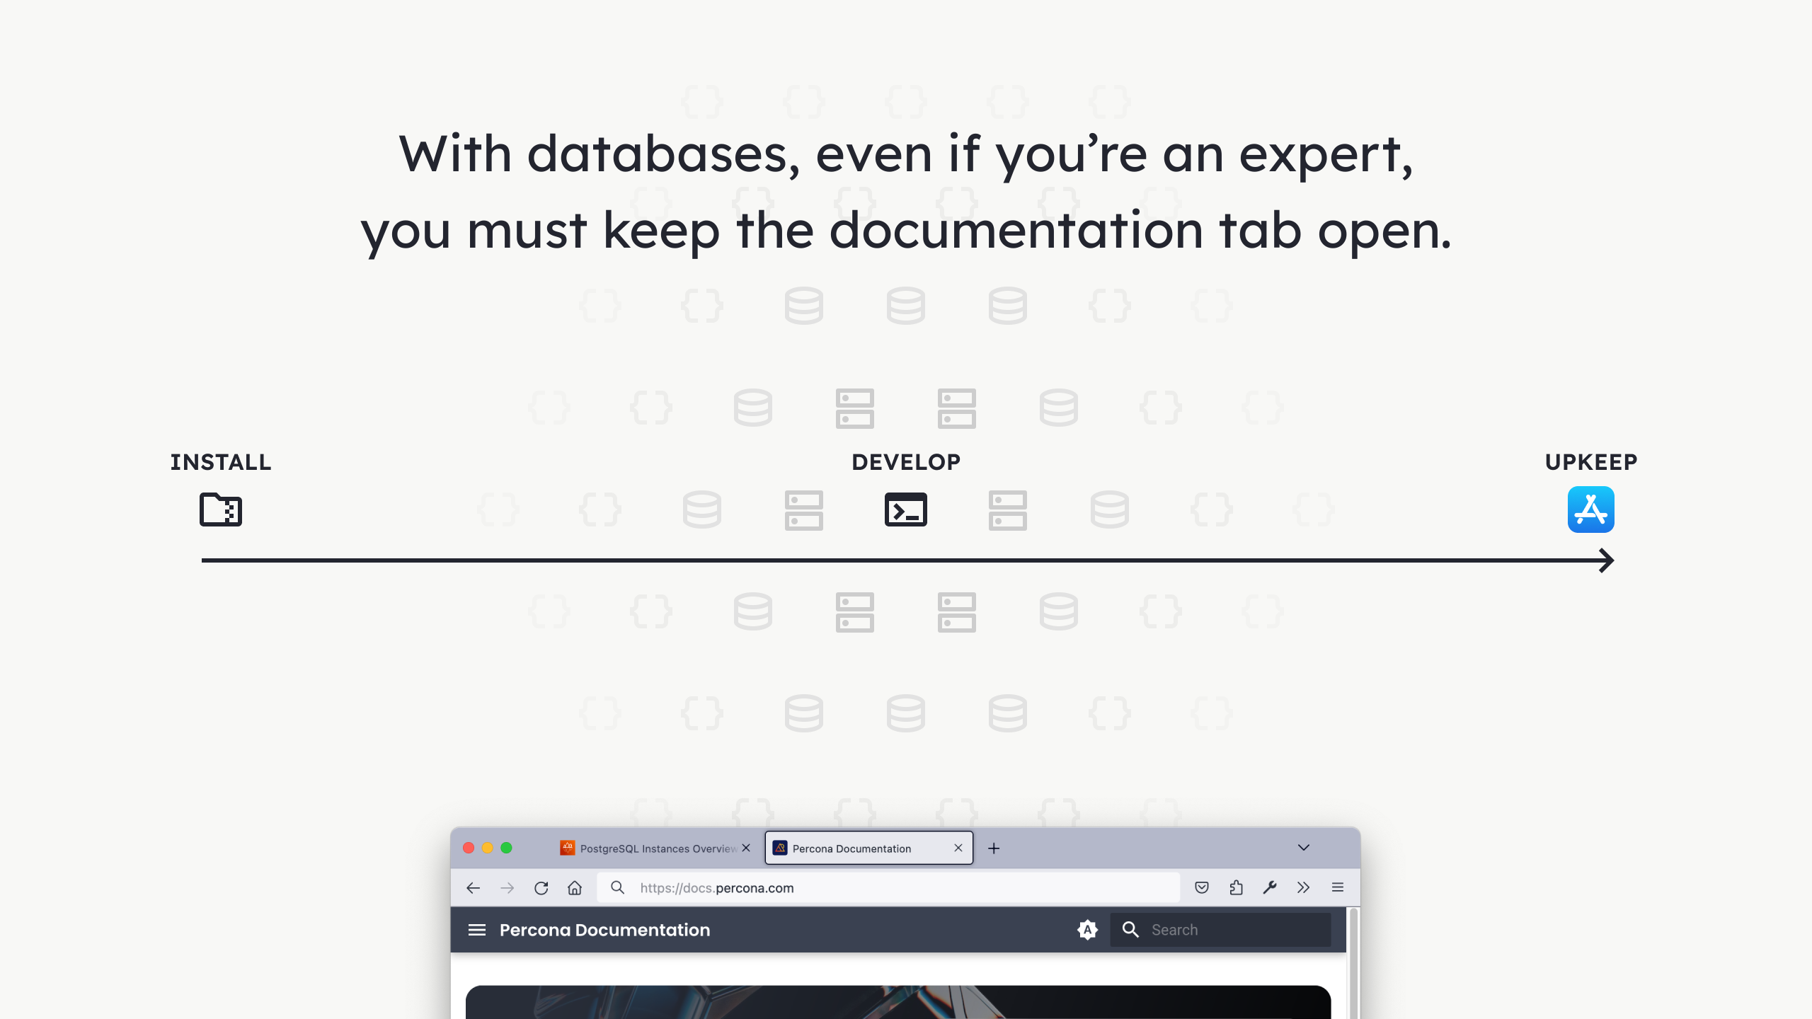
Notes:
Database development -> complexity = high. 1. Installation 2. Development, management and monitoring 1. An entire world 2. Connections to make 3. Components to upgrade 4. Queries to optimize 5. Security concerns 6. Performance concerns 7. And more 3. Application 1. Maintain 2. Optimize

Slide 12
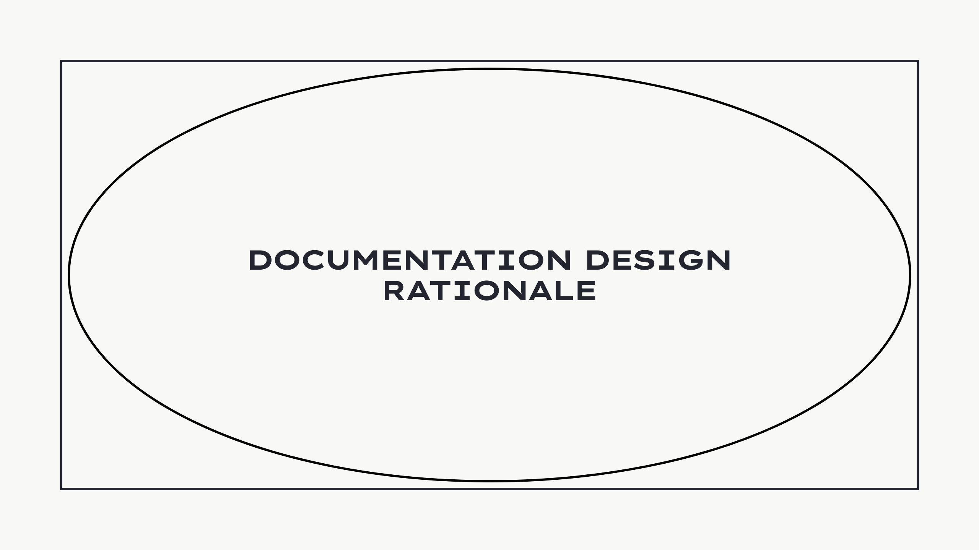
Notes:
- What we did - What we learned - What we think - Open discussion - Spark ideas

Slide 13
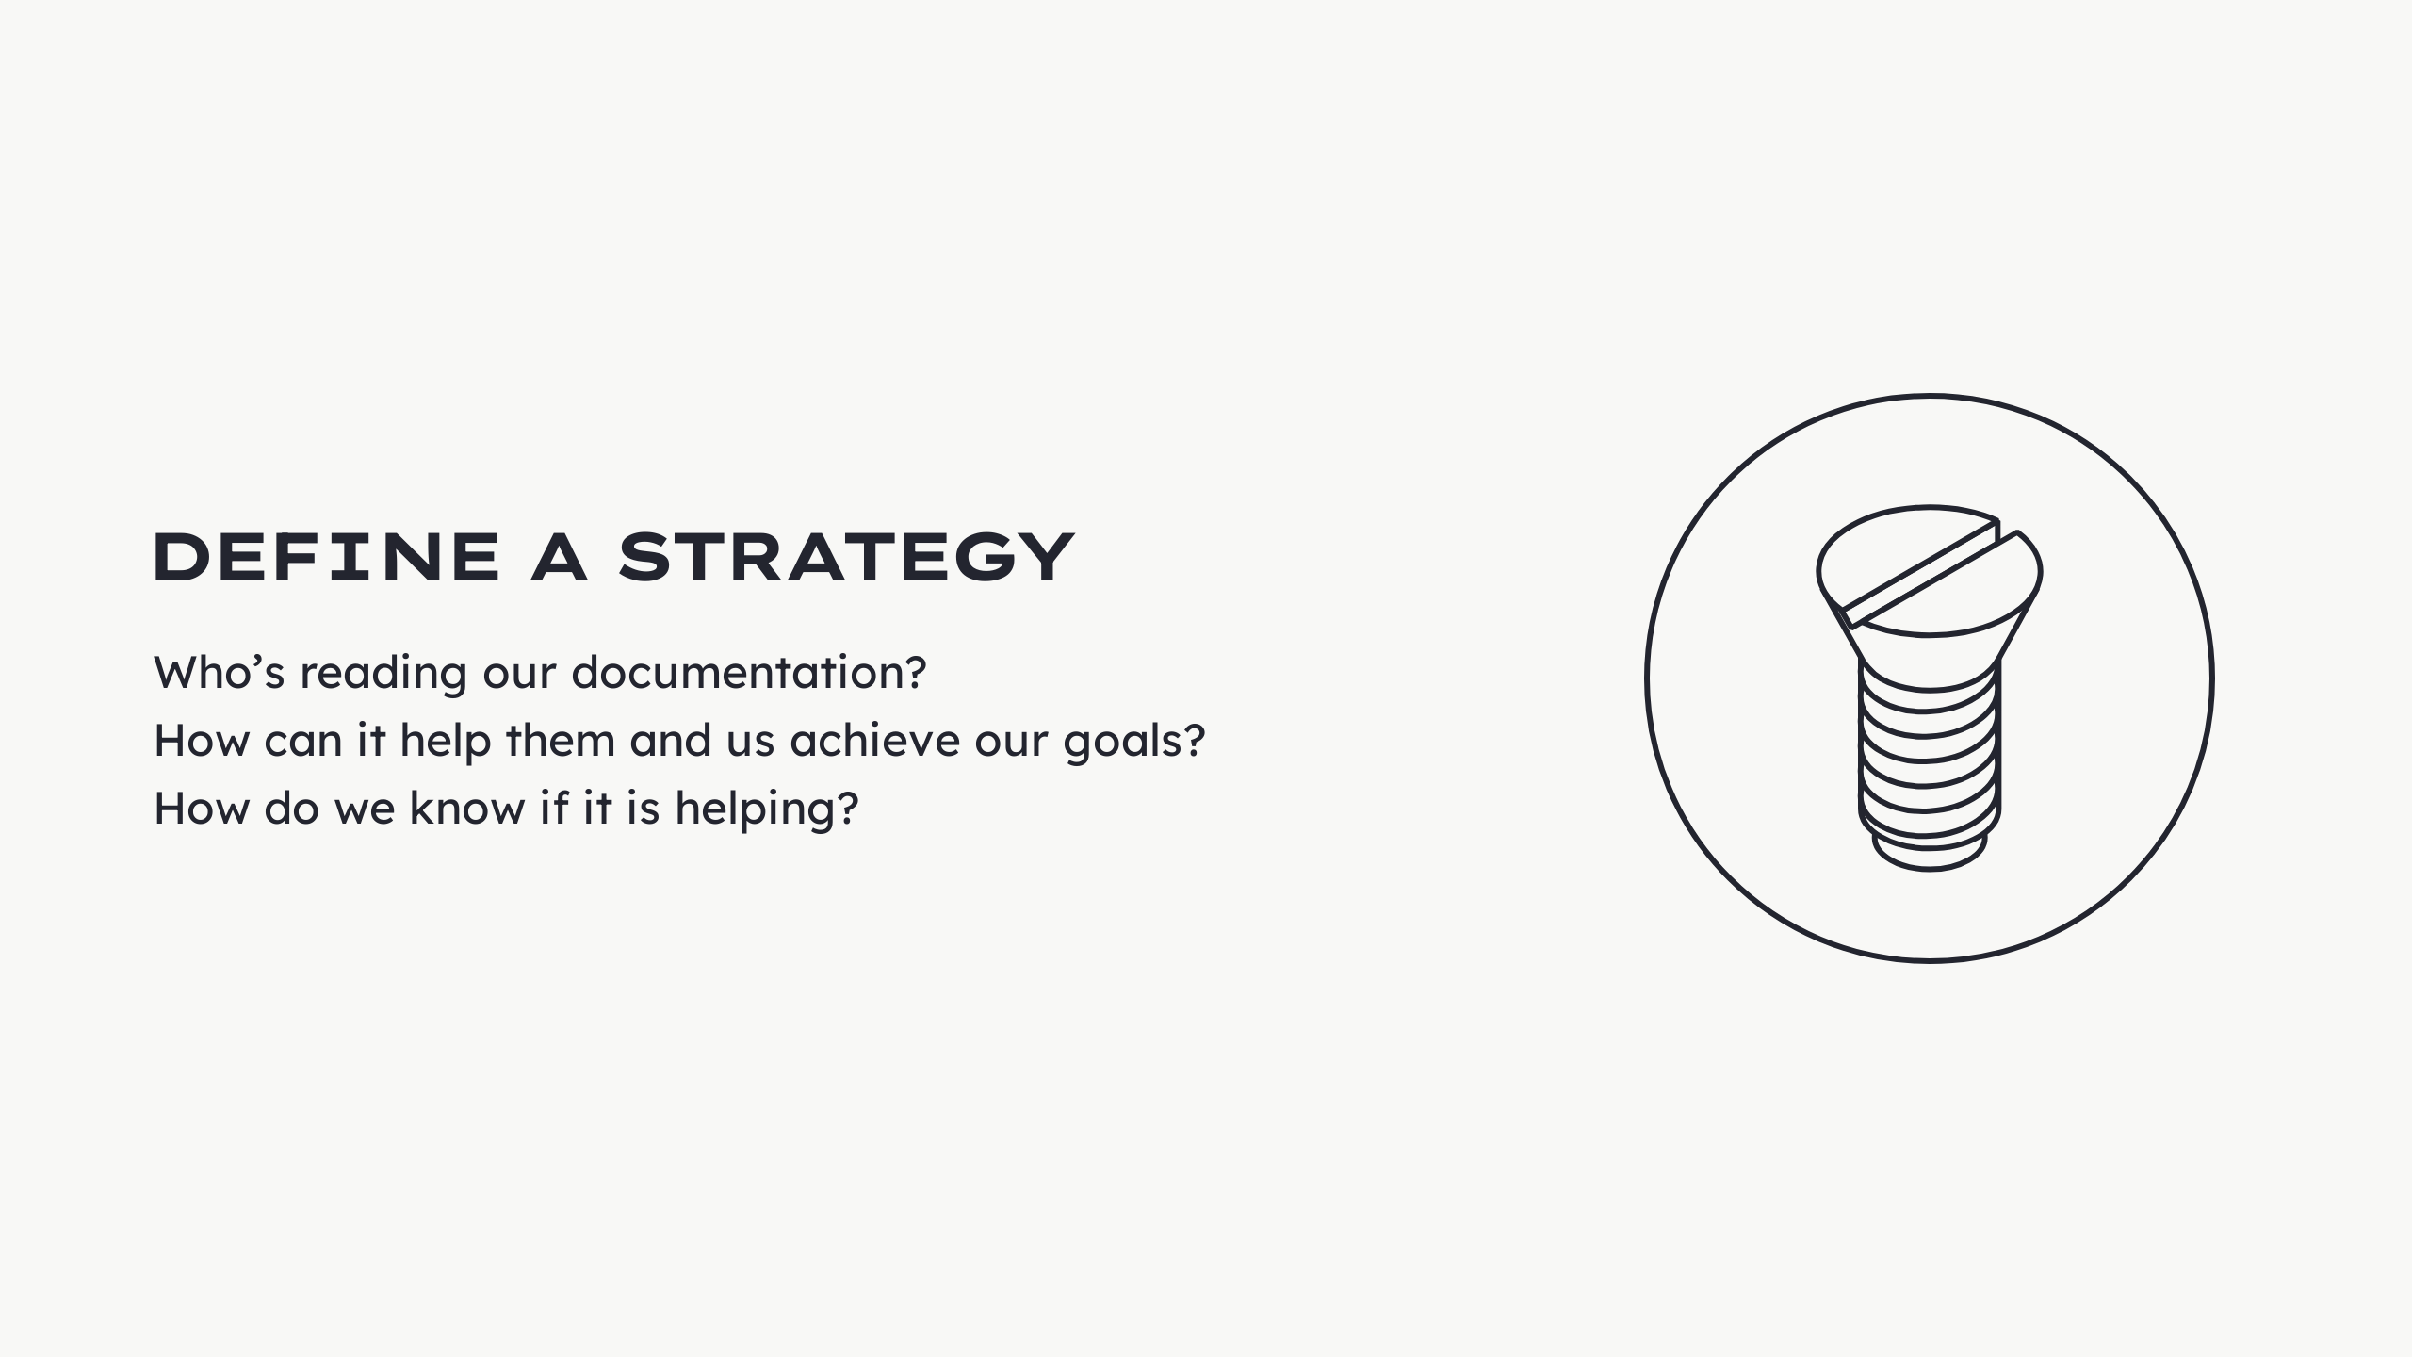
Notes:
Problem: - No clear strategy - Not an instrument to achieve goals. We wanted to change that and ask...

Slide 14
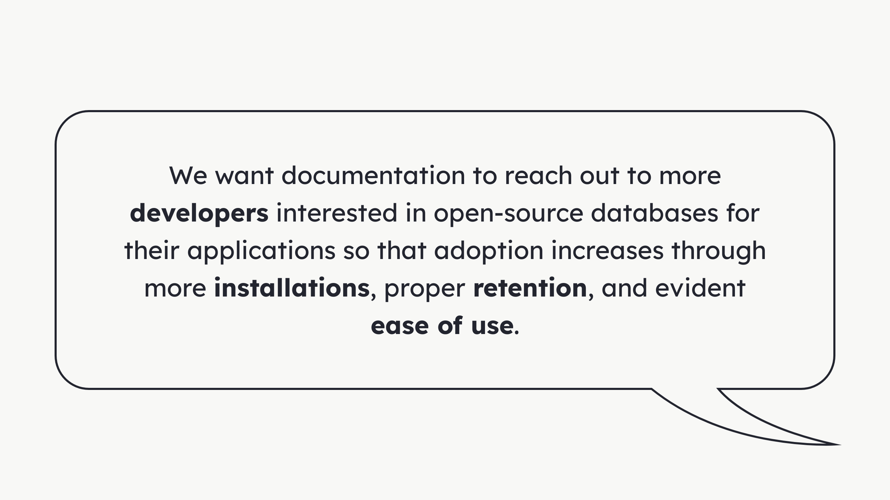
Notes:
- Focus on developers - Not - Database administrators - Reliability engineer - They continue to be our focus - But - Developers need alternatives - Independence - Often lack diverse teams Extra: - Identify people and audit accessibility - Set objectives - Define the action scope - Establish the ownership - Set standards - Define tech stack - Pick health metrics - Set feedback streams - Plan maintenance

Slide 15
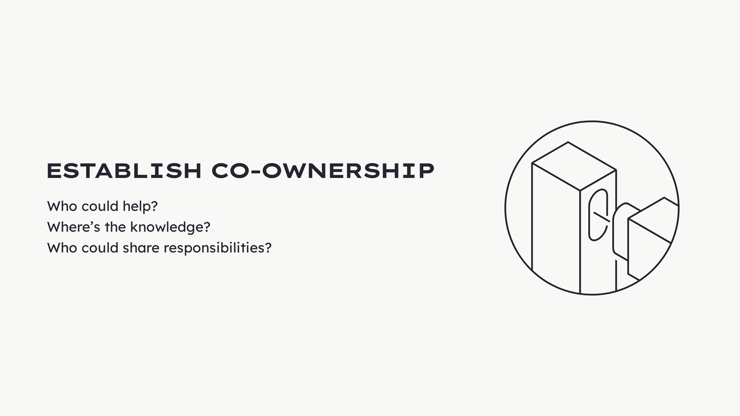
Notes:
Problem: - Documentation just existed - Bare minimum effort - Had to exist cuz we software house This is not enough. We asked...

Slide 16
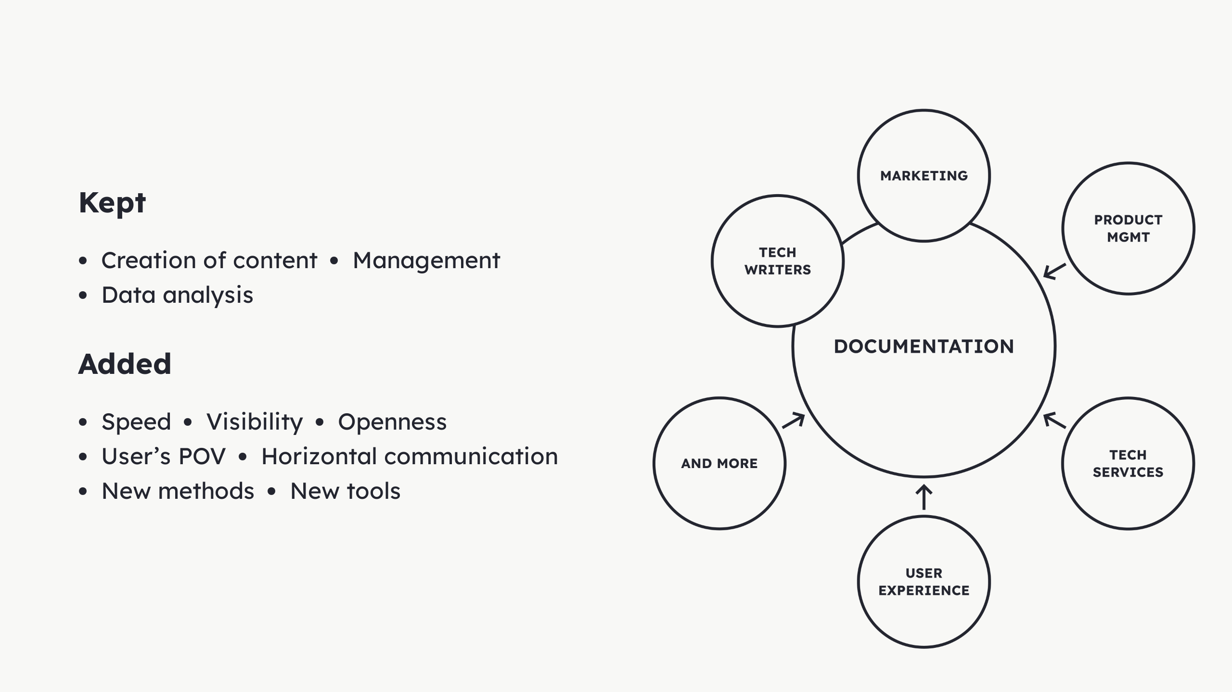
Notes:
Added: - Speed + visibility + openness - More people seeing - Recognizing importance - Incite contribution - We shared all outputs - Brought user representation - Technical Services - Account managers - Customer success - More empirical knowledge - PMs helped - Communicate horizontally - Draw attention - Move things - Garner resources - Product POV - UX team - New ways of doing - Propose solutions - Explored new tools - Posthog

Slide 17
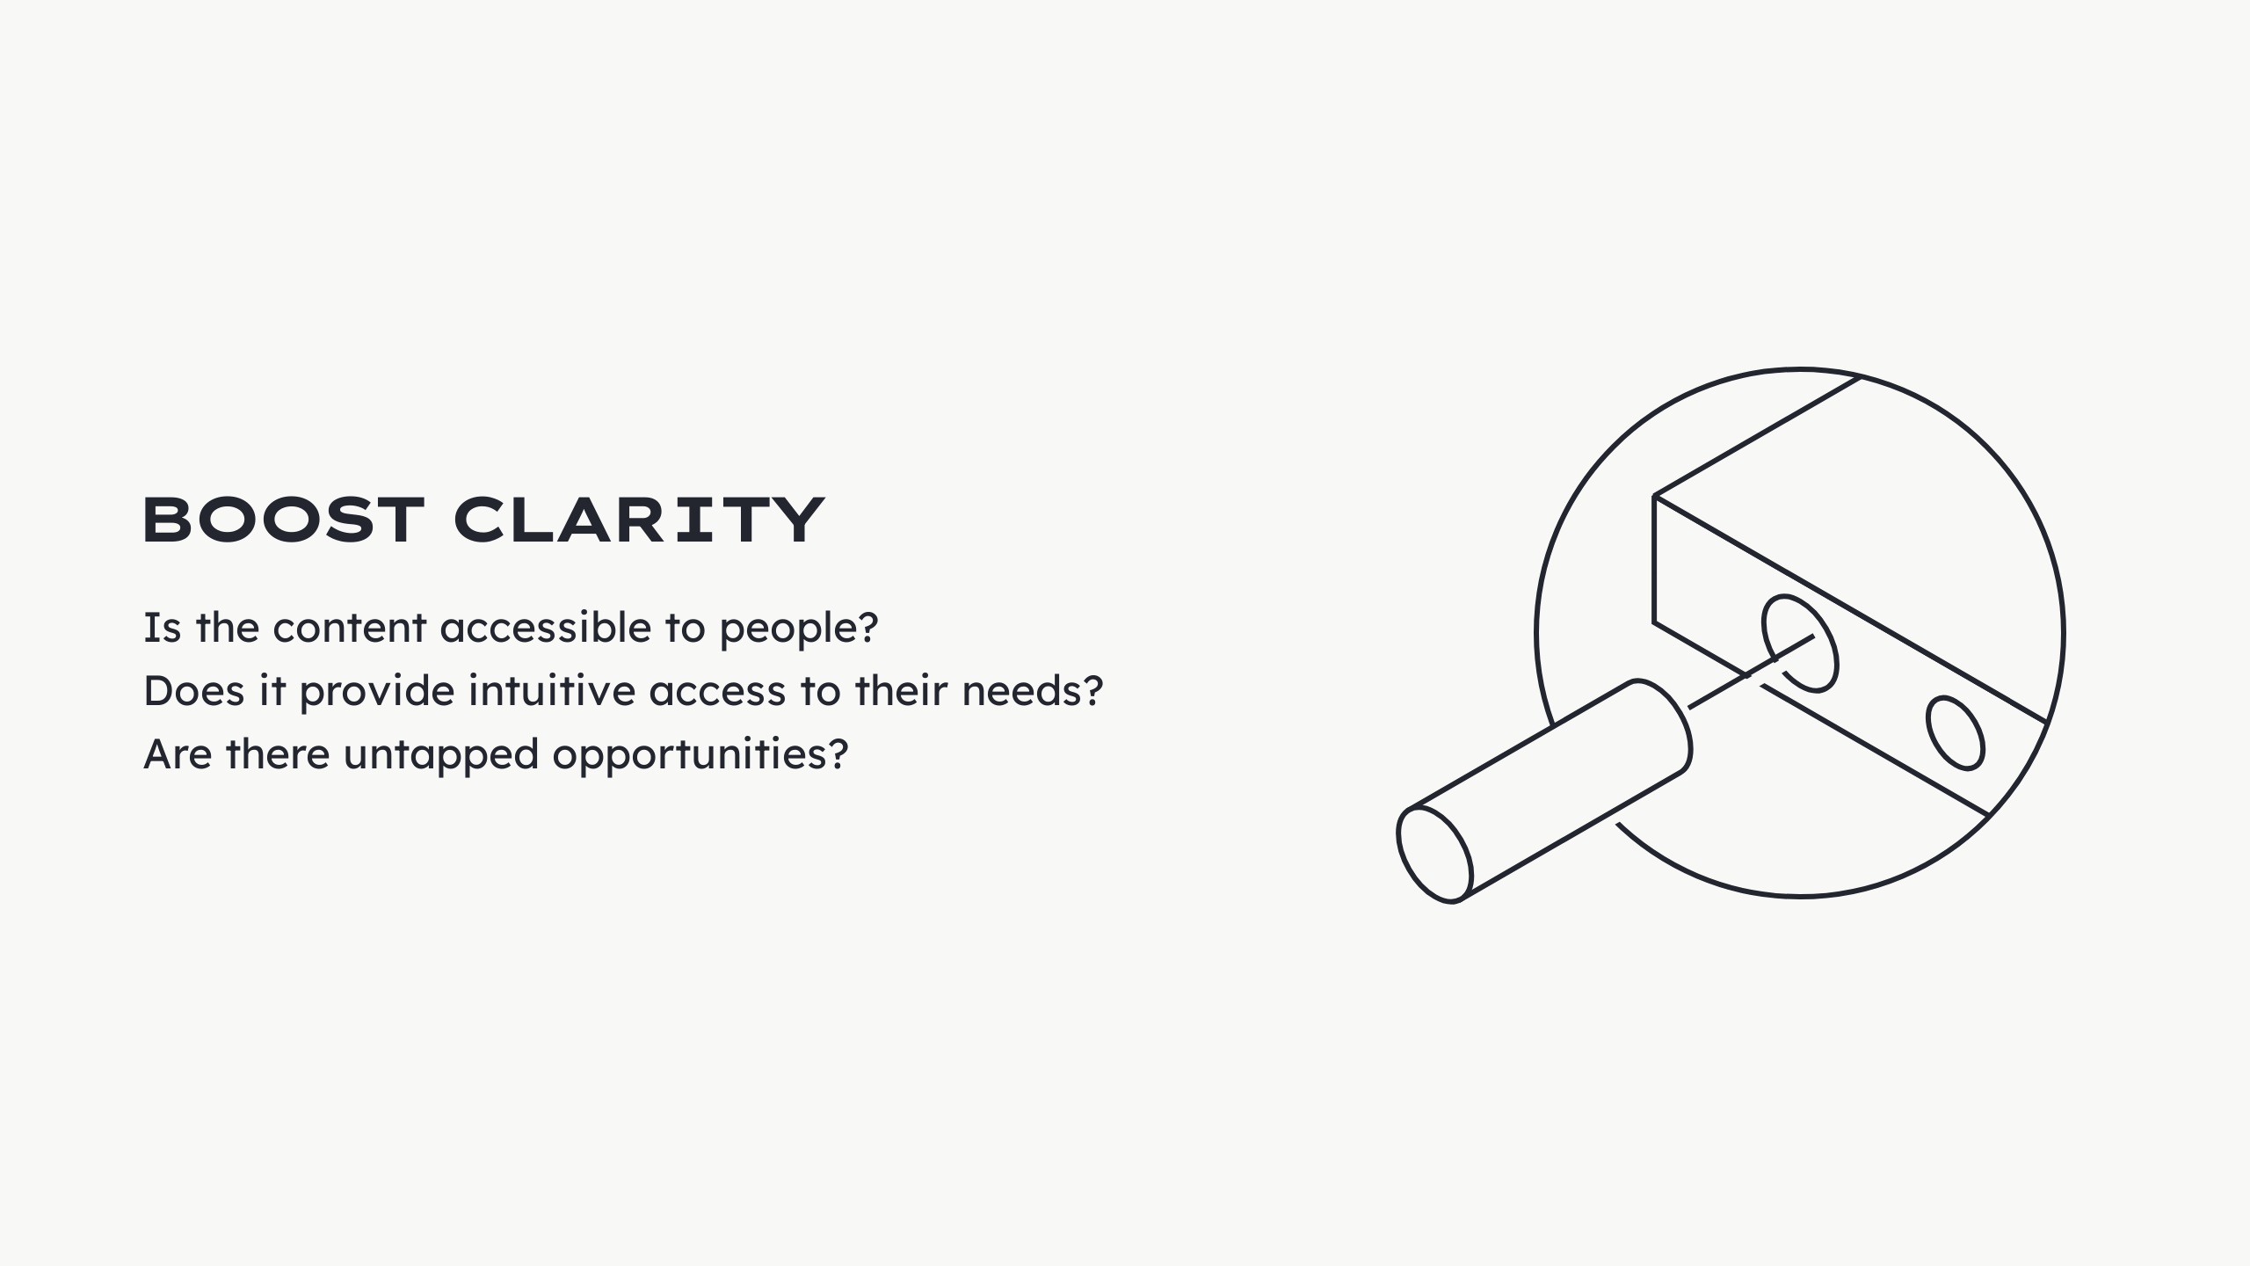
Notes:
We wanted to ask... In practice: - Audited websites - Analysis from UX POV - Found mistakes - Found opportunities

Slide 18
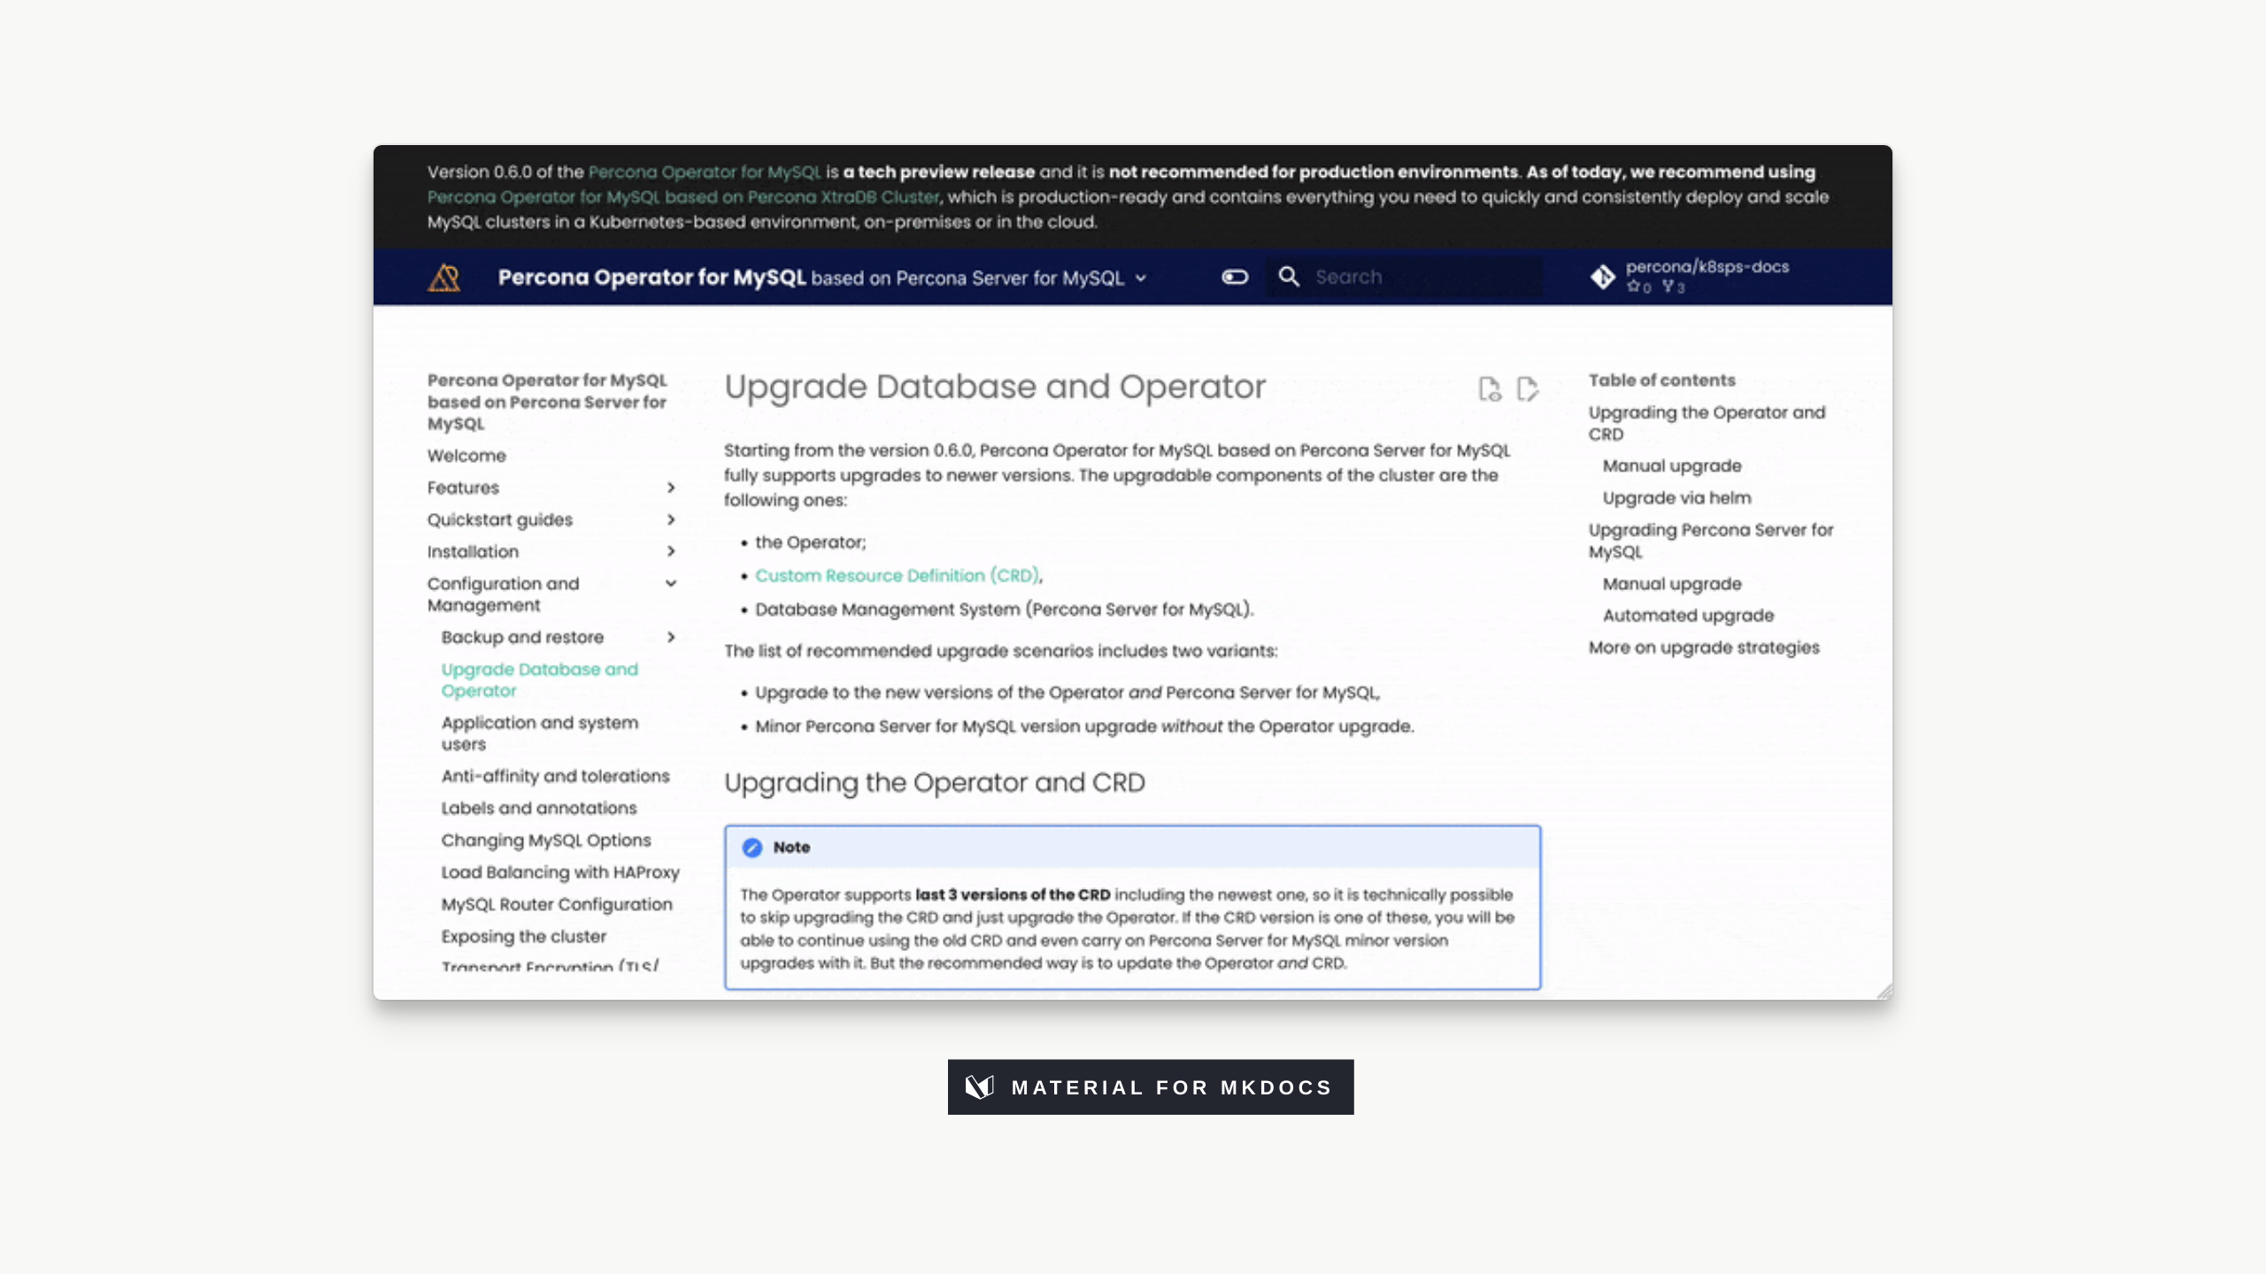
Notes:
<video width="858" height="483" autoplay controls mute loop src="../img/docs-design/old.mp4"></video> - Example of what we had - We had 17x websites like this - Built in MkDocs + Material theme - Flexible - Practical - Beautiful theme - Open-source - A lot of alternatives exist

Slide 19
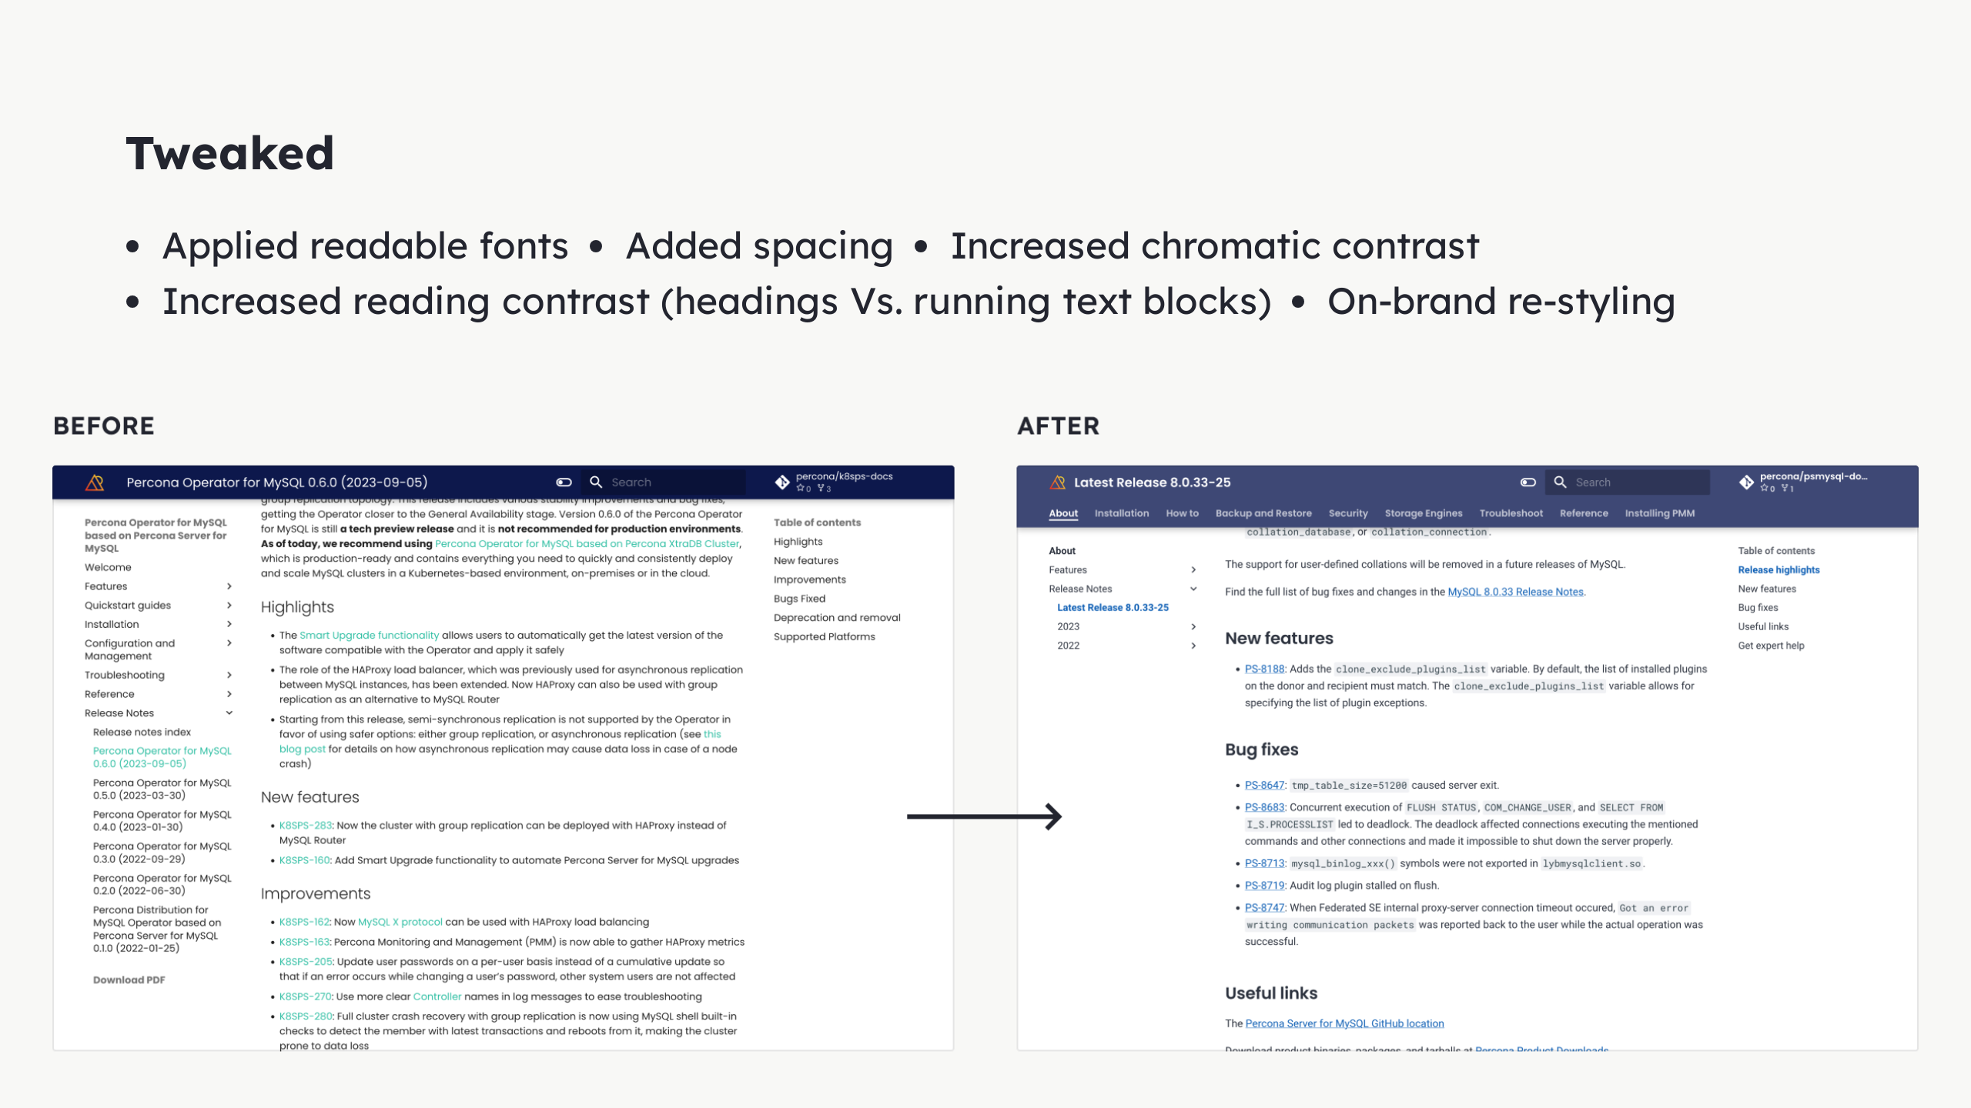

Slide 20
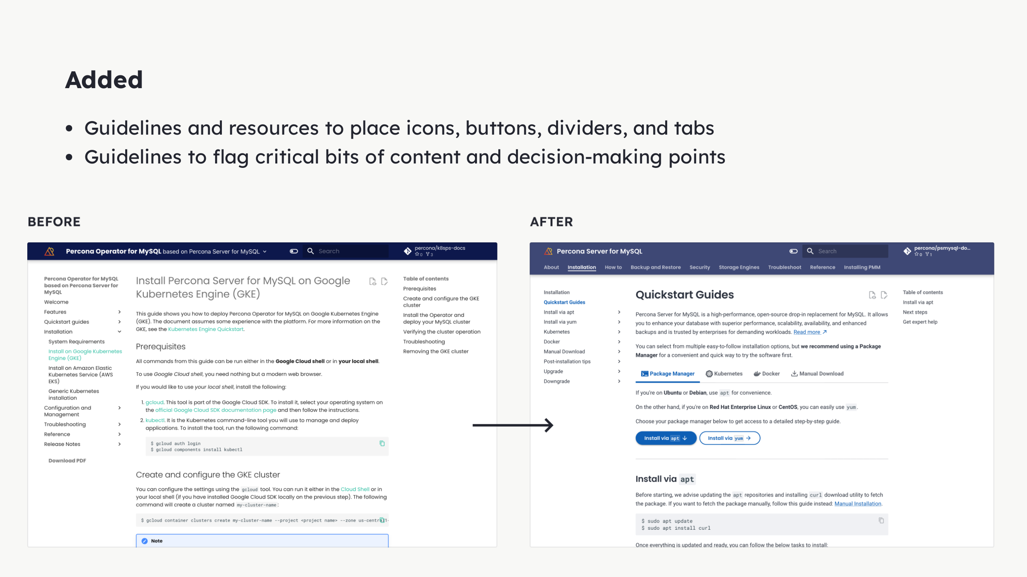
Notes:
- Not using the full potential - Maintainers: not versed on visual arrangement - UX team open to help

Slide 21
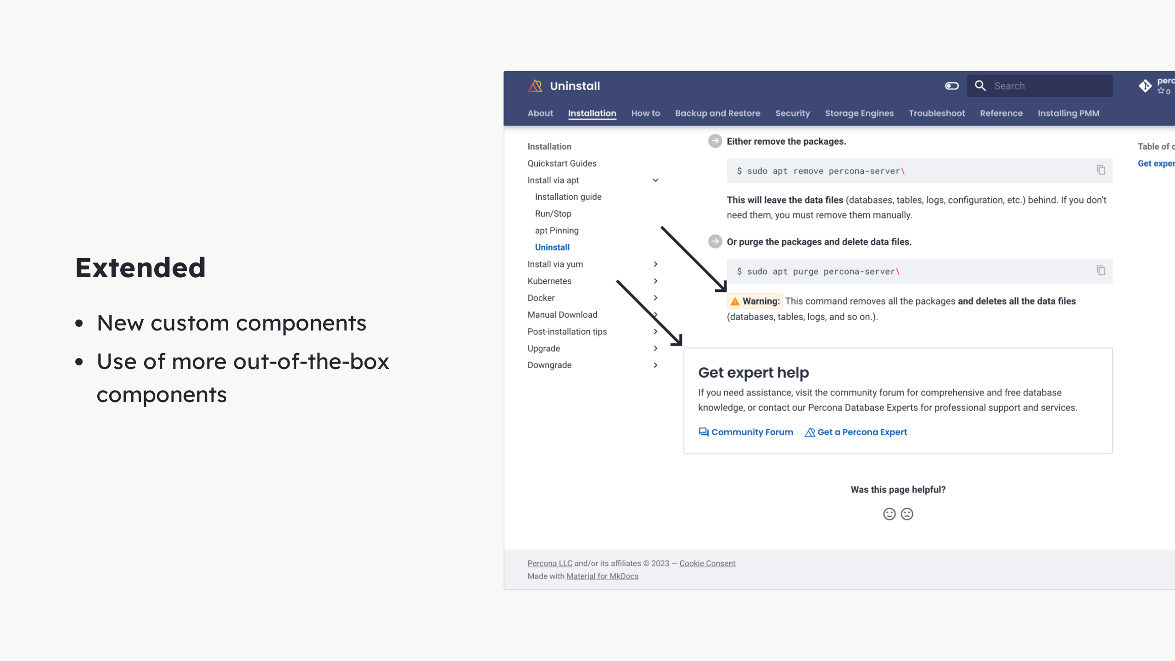
Notes:
MkDocs — great out of the box, but we wanted more: - New components - Tiny Admonitions - When you want more subtle - Framed Content - When you wish to disrupt - Announce - Use of more - Feedback module

Slide 22
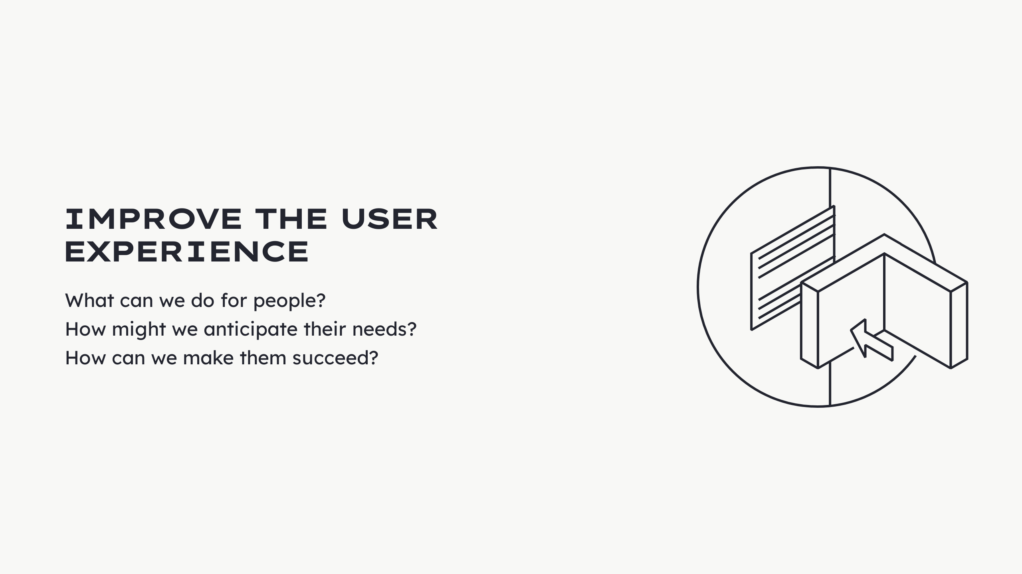

Slide 23
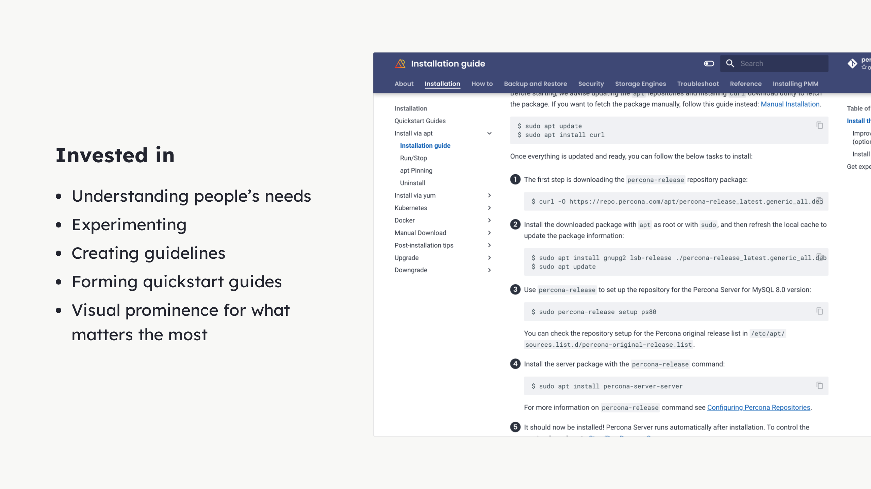
Notes:
- Research - Talked with - Talked with experts - Garnered the needs - Experimentation - Navigation - Top navigation added unnecessary confusion - In our case - When overlaid with side navigation - 2 different patterns don't work - To improve side navigation - Guidelines - Make navigation slimmer - Streamlined - Clear - Uncluttered - Form narratives - Guides - Quickstart experience - Guide to obvious paths - Lead to value of product through docs - To reinforce storytelling - Highlighting steps

Slide 24
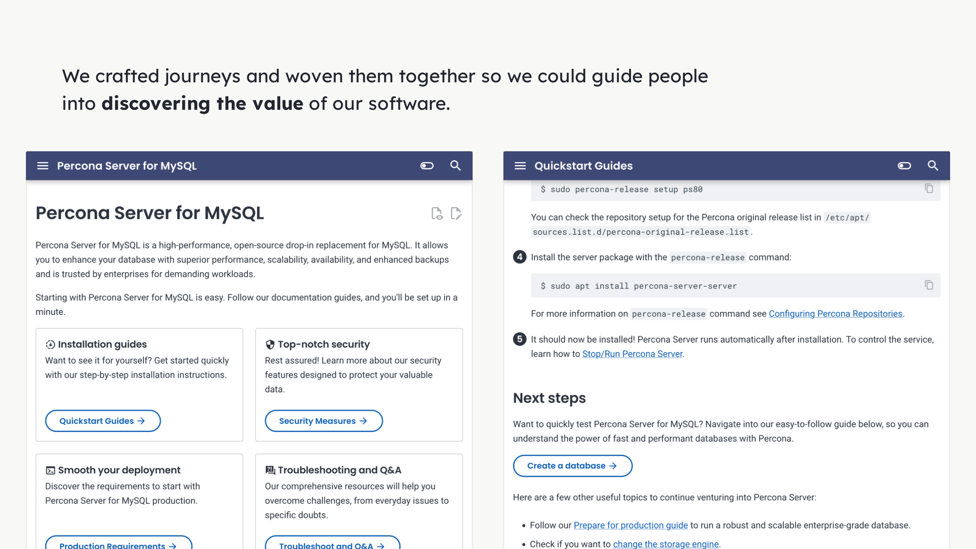
Notes:
We used all of these visual cues we have created. We applied them were it made sense. The objective was to signpost the most likely journey to the user. While always providing alternative routes.

Slide 25
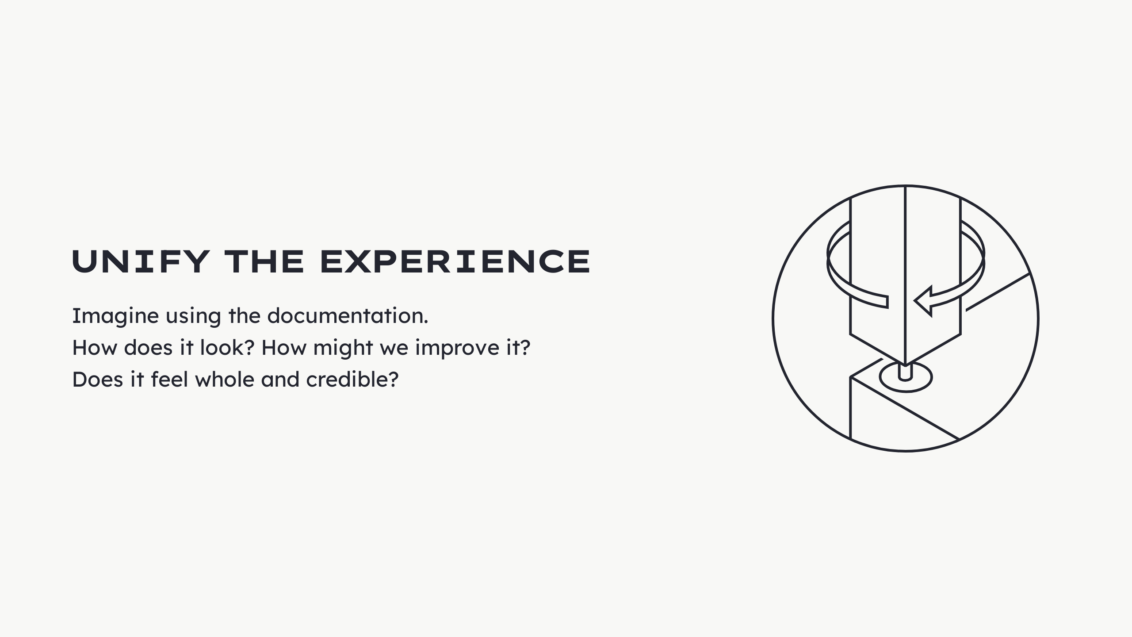

Slide 26
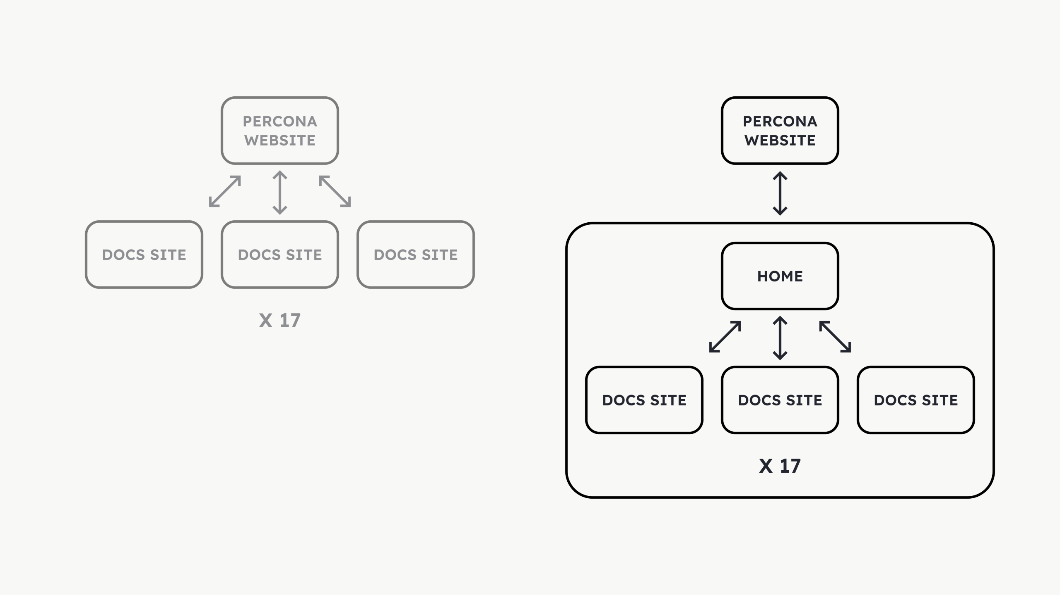
Notes:
Problems: - Documentation left by chance - Disconnected experience - Force user to jump - Main site - To docs - Back to main site - Maintenance problems - 2 places - Different departments - Wordpress - MkDocs - Navigation was unclear - No return Solution: - Move the home page - Make it easy to maintain - Cohesive experience - Same navigation - Same styling - Feeling of wholeness - Boost aesthetic-usability - Perceived professionalism - Perceived functionalism - Things will work

Slide 27
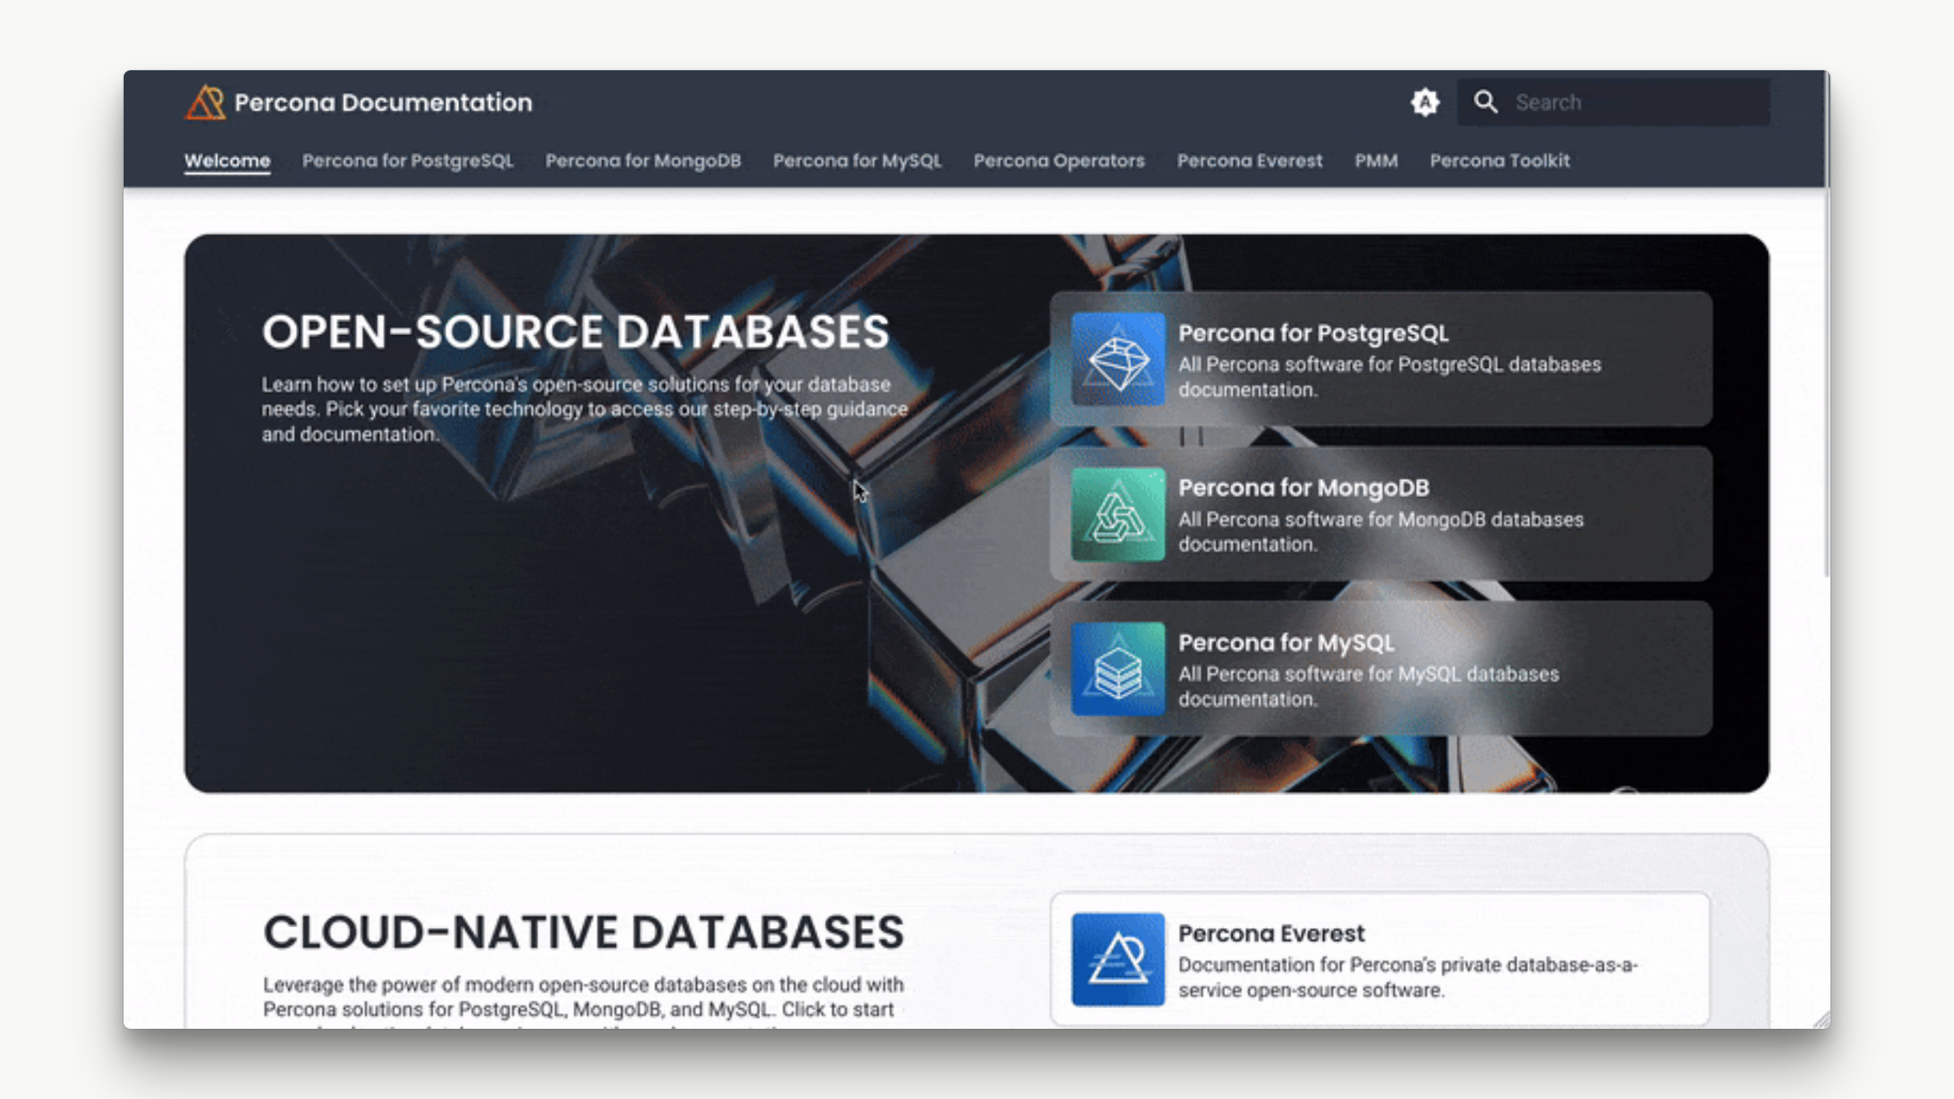
Notes:
<video width="1120" height="630" autoplay controls mute loop src="../img/docs-design/home.mp4"></video>

Slide 28
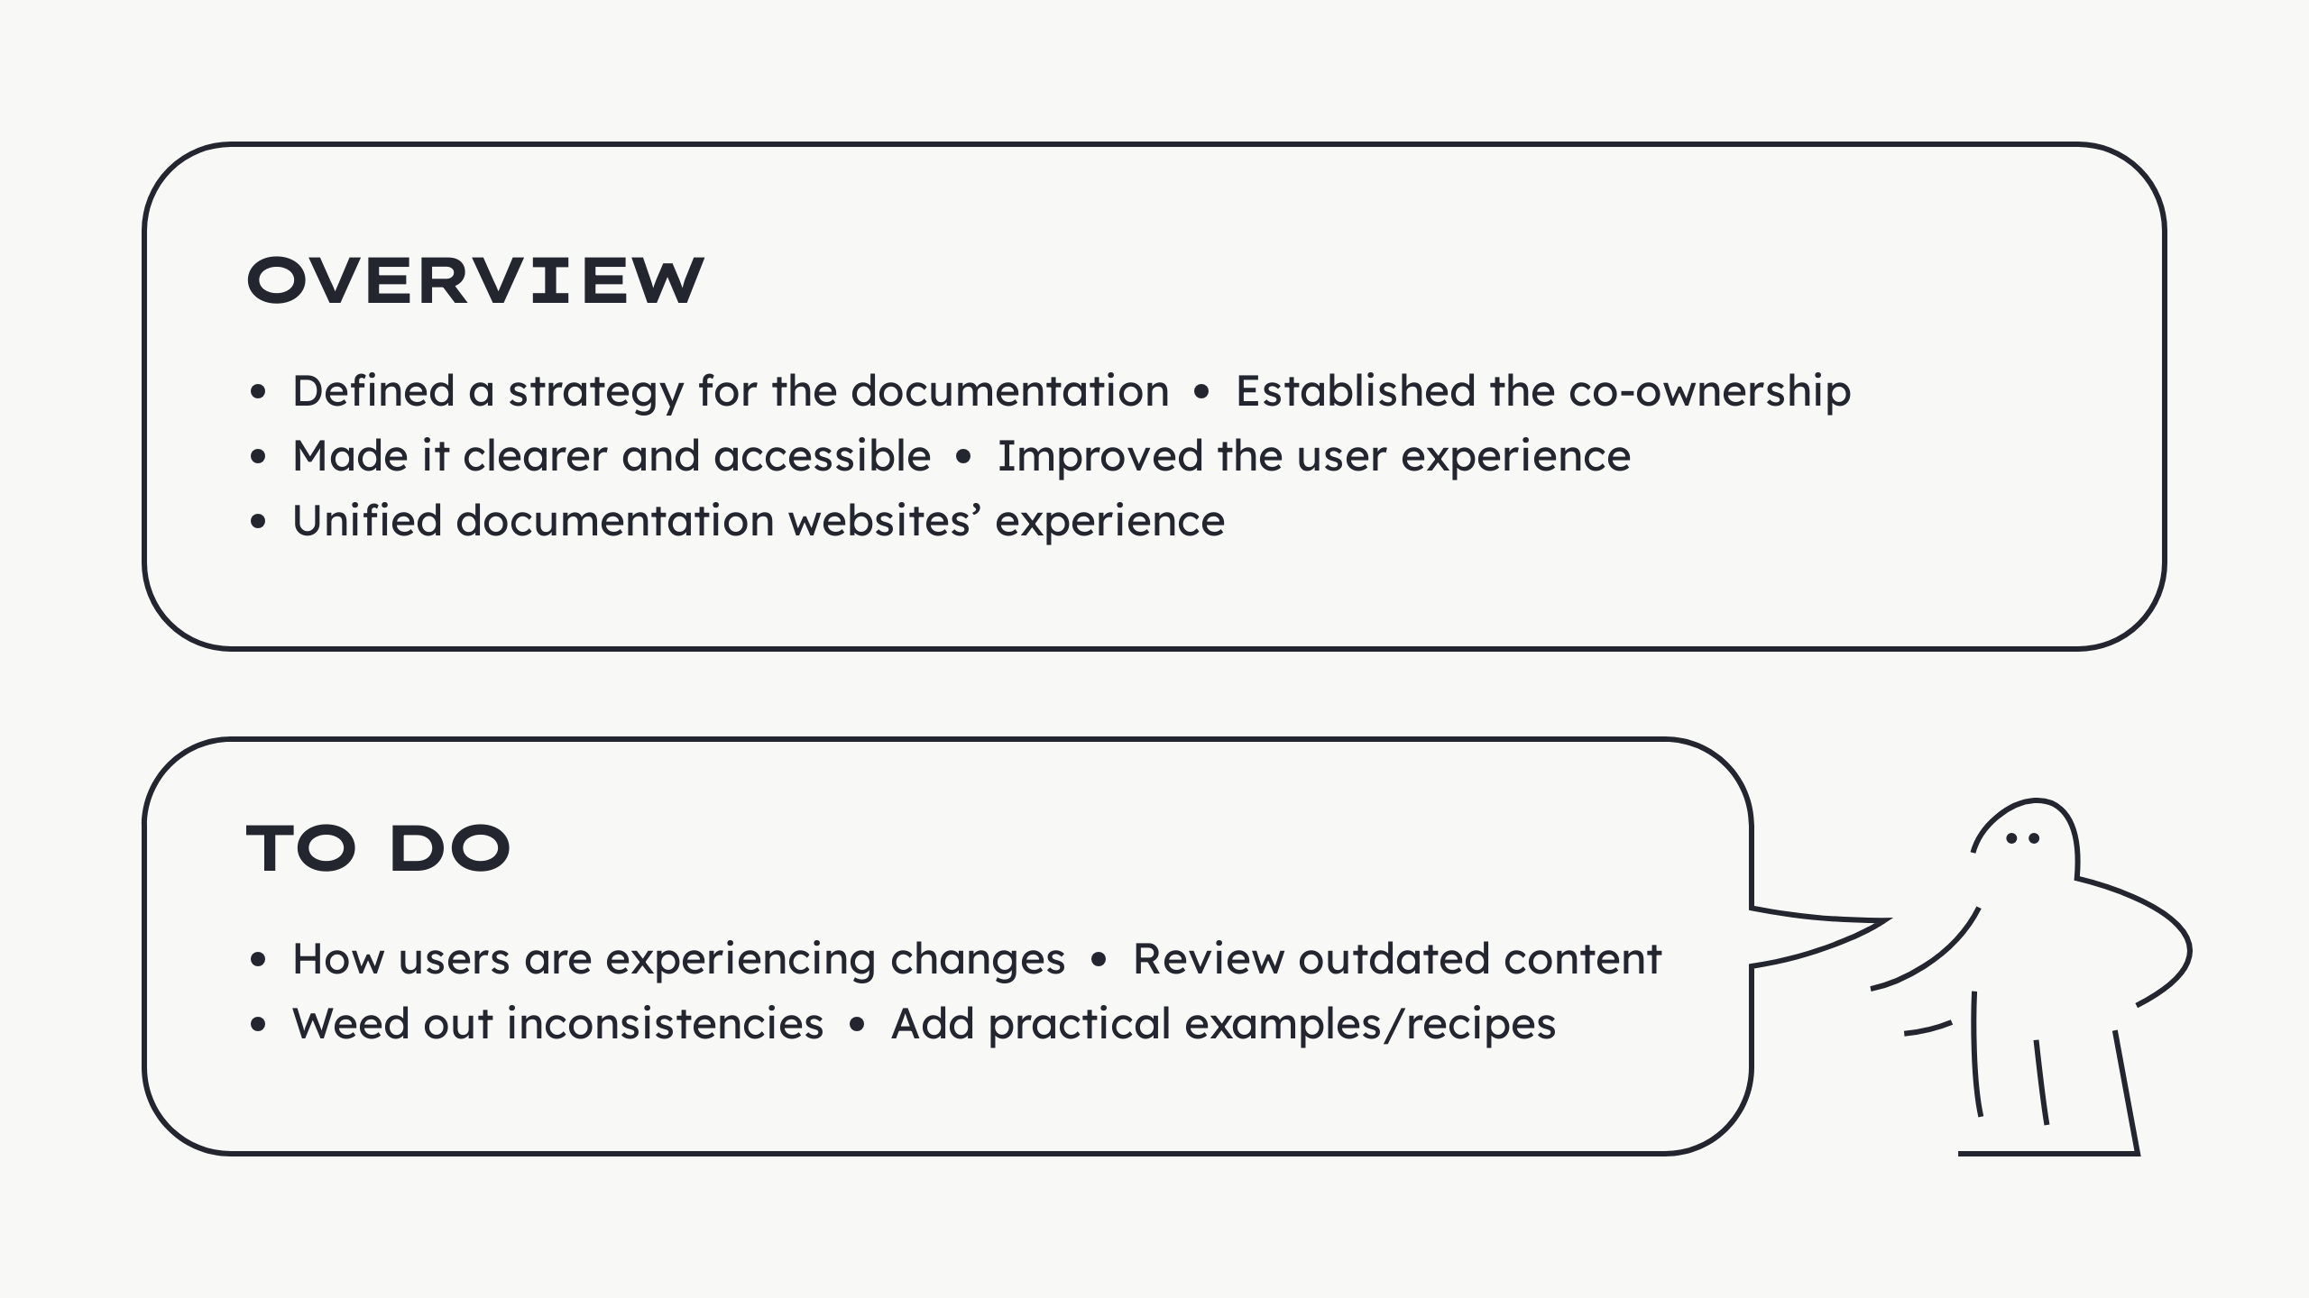
Notes:
- Defined a strategy for the documentation - Generate consensus - Understand the usefulness - Established the co-ownership - Share responsibility - Garner expertise - Made it clear and accessible - Readable - More visible - Tweaked where needed to meet needs - Shaped a better user experience - Researched - Experimented - Created guidelines - Made the obvious journeys clearer - Unified the experience

Slide 29
